Slide 1

Team Details
Team name: Pixel Pioneers
Team leader name: Renita Blessina D
Problem Statement: Sensors Track Garbage Level And Notify Cleaning Staff.

Slide 2

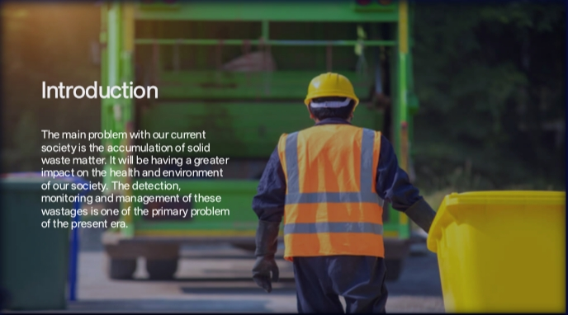

Slide 3
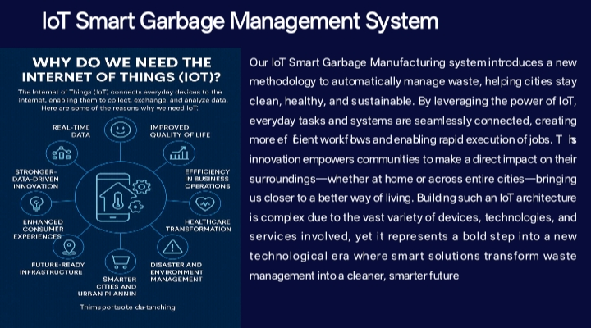
Opportunities
How different is it from any of the other existing ideas?
How will it be able to solve the problem?

Slide 4
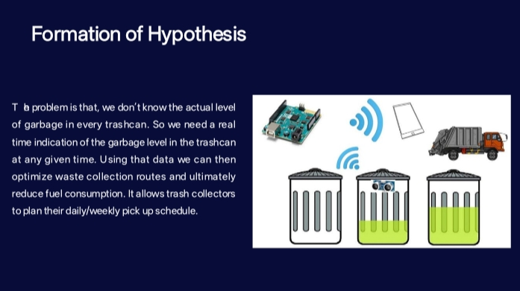
List of features offered by the solution

Slide 5
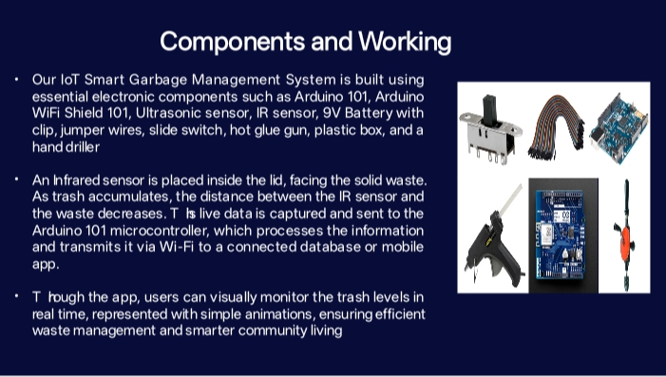
Google Technologies used in the solution

Slide 6
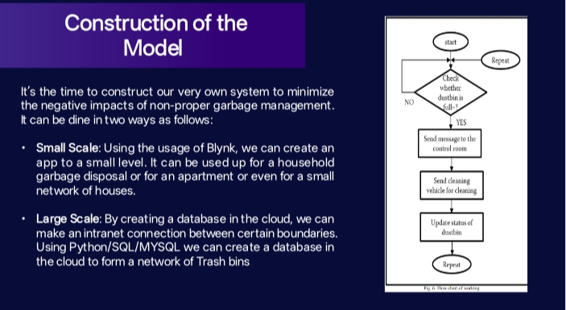
Process flow diagram or Use-case diagram

Slide 7
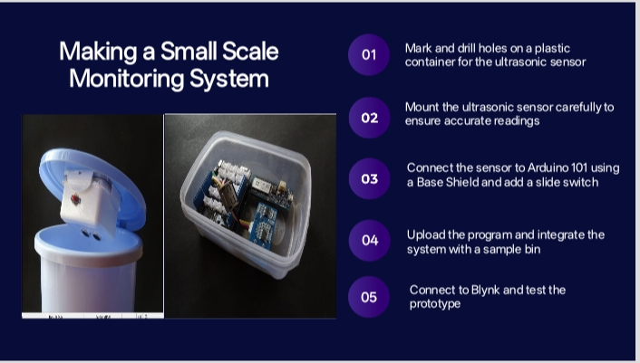
Wireframes/Mock diagrams of the proposed solution (optional)

Slide 8
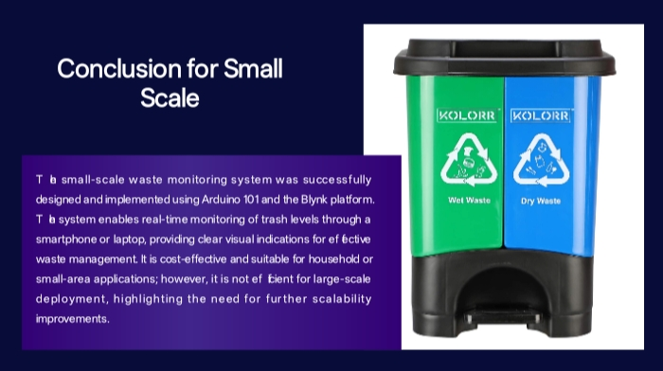
Architecture diagram of the proposed solution

Slide 9
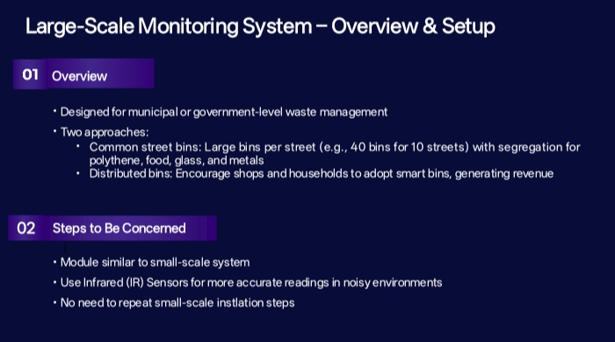
Snapshots of the MVP

Slide 10
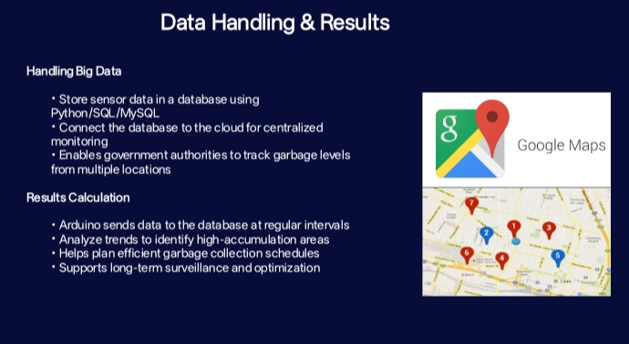
Additional Details/Future Development (if any)

Slide 11
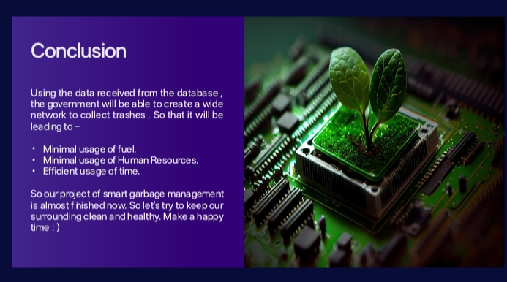
Provide links to your:
GitHub Public Repository
Demo Video Link (3 Minutes)
MVP Link

Slide 12

Thank you!

